Slide 1
Softmax Regression
In R
Brennan Whillock

Slide 2
Agenda
Theory
Data
Iris
Application
R – nnet and caret

Slide 3
Theory

Slide 4
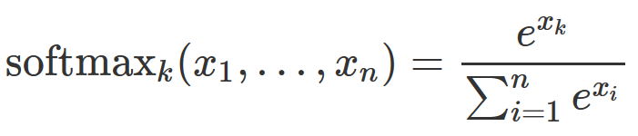
Softmax Function
Input:
Vector of n real numbers
Choice of k in (1, 2, … , n)
Output:
Value between 0 and 1

Slide 5
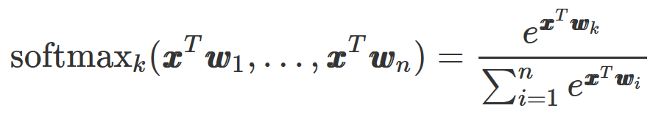
Softmax Function
We frequently see softmax in this form for regression

Slide 6
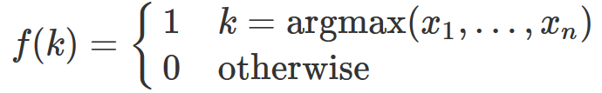
Softmax Function Properties
Smooth approximation to the indicator function
The sum of all n softmax’s is 1

Slide 7
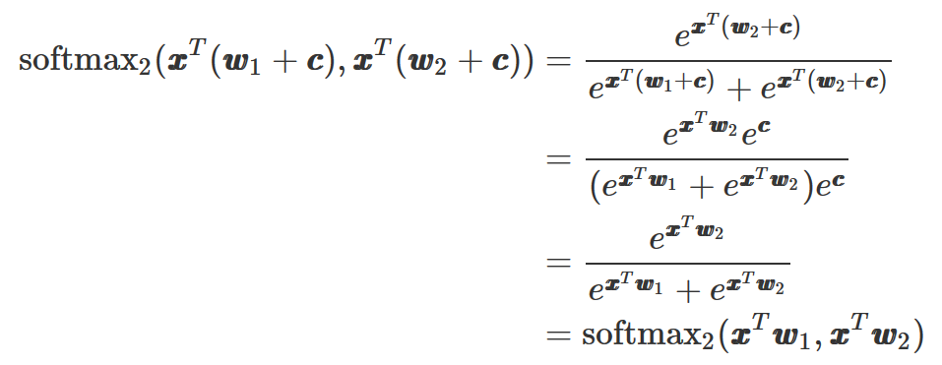
Softmax Function Properties
For any constant vector c :
Proof:

Slide 8
Softmax Function Example
Three different samples
 | value | softmax
x1 | 1 | 0.090
x2 | 2 | 0.245
x3 | 3 | 0.665
 | value | softmax
x1 | 1 | 0.017
x2 | 2 | 0.047
x3 | 5 | 0.936
 | value | softmax
x1 | 1 | 0.000
x2 | 2 | 0.000
x3 | 10 | 1.000

Slide 9
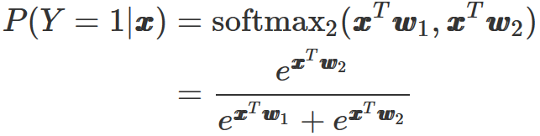
Softmax Regression with 2 Classes – Logistic Regression
Input:
Vector of 2 real numbers
Choice of k=1 or k=2
Output:
Probability Y = k
This model is sometimes used.
However, we can simplify further using the properties of softmax.

Slide 10
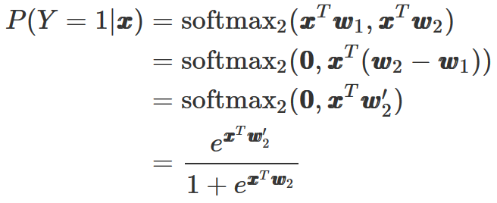
Softmax Regression with 2 Classes – Logistic Regression
Addition of a constant vector c = -w₁ reveals the familiar logistic function

Slide 11
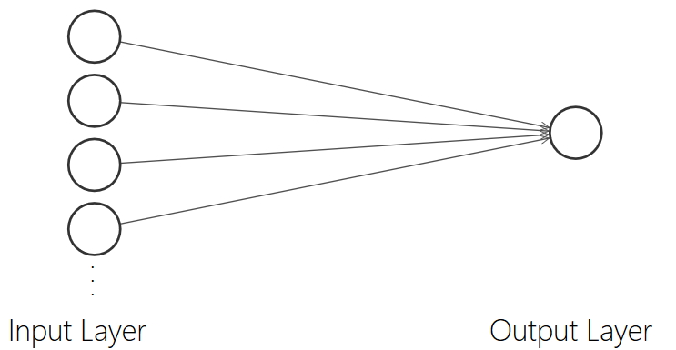
Softmax Regression with 2 Classes – Logistic Regression
Only 4 inputs are shown for clarity

Slide 12
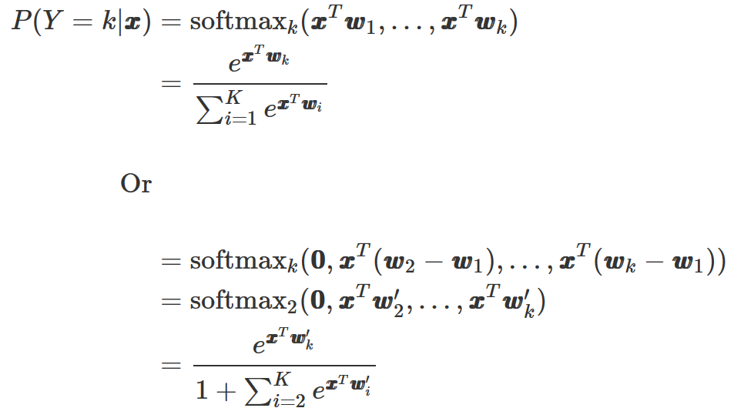
Softmax Regression with k Classes – Multinomial Logistic Regression
Input:
Vector of K real numbers
Choice of k = 1, 2, … , K
Output:
Probability Y = k

Slide 13
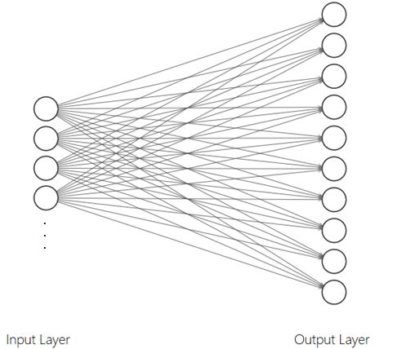
Softmax Regression with 11 Classes – Multinomial Logistic Regression

Slide 14
Bottom Line
Softmax regression is a single layer neural network

Slide 15
Data Overview

Slide 16
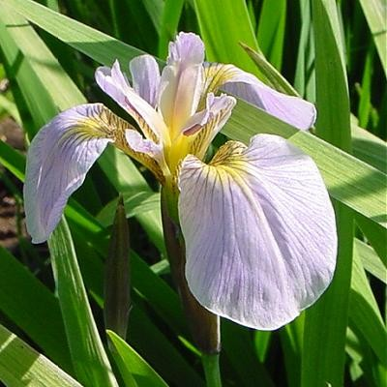
Iris
3-class classification problem
50 observations for each class
Class labels
Setosa, Versicolor, Virginica
4 features
Sepal length, sepal width, petal length, petal width
Included in base R

Slide 17
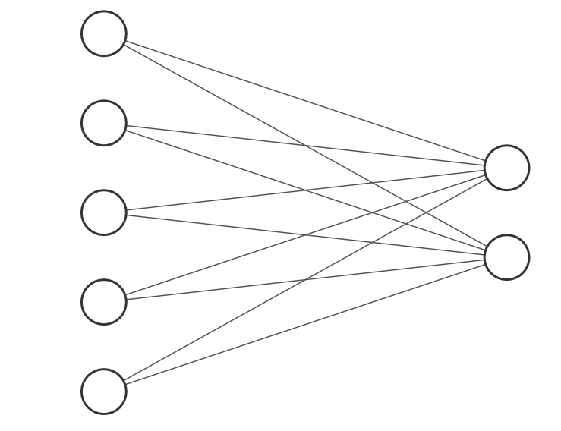
Iris Network Topology 1
Bias
Sepal.Length
P(y=versicolor)
Sepal.Width
P(y=virginica)
Petal.Length
Petal.Width
* P(y=setosa) = 1-P(y=versicolor)-P(y=virginica)

Slide 18
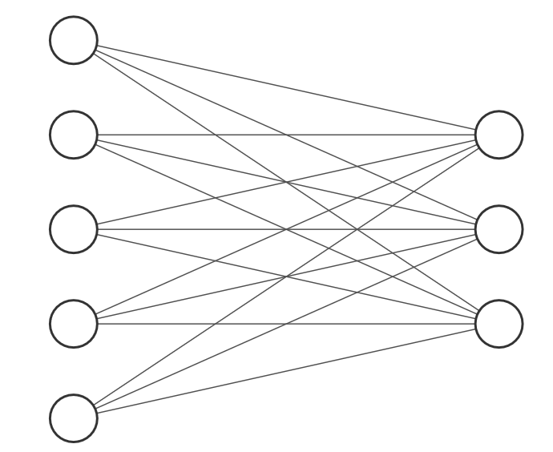
Iris Network Topology 2
Bias
Sepal.Length
P(y=setosa)
Sepal.Width
P(y=versicolor)
Petal.Length
P(y=virginica)
Petal.Width

Slide 19
Application
Break away to code demonstration

